Slide 1
Recording in session
Notes:
Press the Record button.
This virtual session is being recorded.

Slide 2

Current district priorities
2023-2024 School Year (sy)
2024-2027 Three-Year LCAP Development
LCAP | Educational Partner Engagement | December 4, 2023
Notes:
Good morning and thank you for joining for the LCAP Engagement Session #2 focusing on Current District Priorities for the 2023-2024 School Year. This is supporting the development of the 2023-2027 Three-Year LCAP Plan. This LCAP Engagement Session is in support of the LCAP Educational Partner Engagement process on December 4, 2023.
Again thank you for being part of the authentic efforts by Stockton Unified School District

Slide 3
Recording in session
Notes:
As a reminder, this virtual session is being recorded.

Slide 4


Welcome
Welcome / Opening
Superintendent Dr. Michelle Rodriguez
English: https://www.stocktonusd.net/cms/lib/CA01902791/Centricity/Domain/142/SUSD%20State%20of%20the%20District%202023%20-%20English.pdf
Spanish:
https://www.stocktonusd.net/cms/lib/CA01902791/Centricity/Domain/142/SUSD%20State%20of%20the%20District%202023%20-%20Spanish.pdf
https://www.stocktonusd.net/Page/17757

Slide 5
AGENDA
Current District Priorities – 2023-2024 School Year (SY)
Topics:
LCAP Engagement In 2023-2024
LCAP and SUSD Guiding Principles
Prior Engagement Session Recap
Opportunities to Build Trust Through Authentic Engagement
2023 – 2024 Priority Recommendations
Connecting Priorities
Next LCAP Engagement Session

Slide 6
LCAP Engagement in 2023-2024
11/28: Introduction: LCAP Fundamentals
12/04: Current District Priorities – 2023-2024 School Year
01/19: LCAP Mid-Year Update and Funding
02/09: Data Analysis / District Areas of Need
02/19: Budget Projections
03/05: Survey Results and Key Findings
03/08: Identified District Goals/Activities
* April 2024: Post Draft 2024-2027 LCAP
* May 2024: Public Hearing 2024-2027 LCAP
* June 2024: Board Adoption 2024-2027 LCAP

Slide 7
LCAP and SUSD Guiding principles
IMPROVING
STUDENT
OUTCOMES

Slide 8
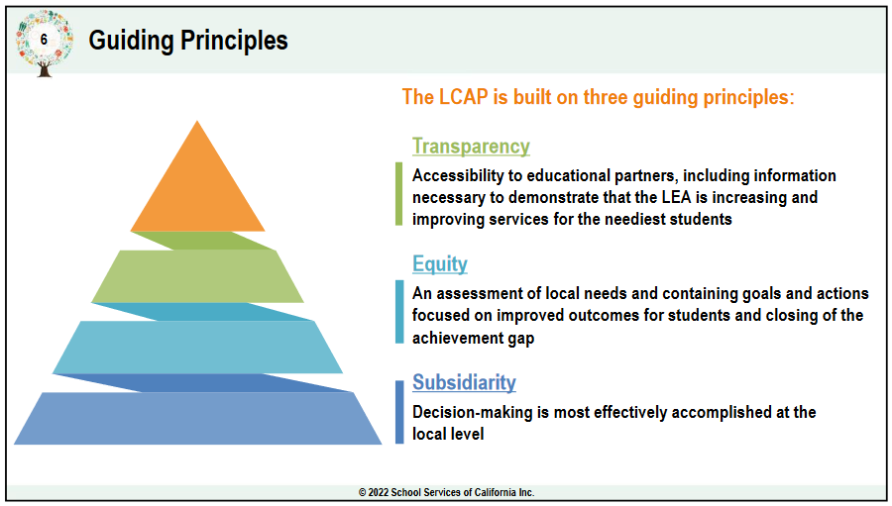
LCAP Guiding Principles
Transparency in SUSD
Inclusive communication and information to support decisions.
Equity in SUSD
Supporting students not on what is fair or equal, but equitable.
Subsidiarity in SUSD
Lowest level of decision-making, which is based on data and identified needs with input from educational partners.

Slide 9

JOY, TRUST, and Belief: Pillars of Success for SUSD
1 interaction
1 decision
1 day at a time
https://youtu.be/XKgMskwgHog?si=oyddC_MLMpyR2w29

Slide 10
Think time – Question 1
Celebrating Joy:
Superintendent Dr. Rodriguez says in this video,
“We will bring joy into our schools…”
Question 1:
What would JOY in the life of your student look like at school?
2 minutes to Post your comment(s) in the chat box.
Notes:
Write your response below:

Slide 11
Think time – Question 2
Celebrating Joy:
Superintendent Dr. Rodriguez says in this video,
“We will bring joy into our schools…”
Question 2:
What does your family value that brings you continuous JOY?
2 minutes to Post your comment(s) in the chat box.
Notes:
Write your response below:

Slide 12

Prior engagement session recap
CIRCLING
BACK

Slide 13
Introduction: LCAP fundamentals
Topics Presented:
LCAP Requirements and Components
  LCAP Development
  LCAP Lifecycle
  LCAP Requirements
  Educational Partners
  LCAP Approval Process
  Local Control Funding Formula
LCAP and School Plan for Student Achievement (SPSA) Alignment
Accessing the LCAP?
SUSDs LCAP is available on the district’s webpage: https://www.stocktonusd.net/Page/16289
This webpage also provides a central location for updates on current LCAP activities and previous.

Slide 14

Opportunities to build trust
Through Authentic Engagement
Joining Together to Create a Bold Vision for
Next Generation Family Engagement
Engaging Families to Transform Education
Carnegie Corporation of New York
https://media.carnegie.org/filer_public/f8/78/f8784565-4bd6-4aa3-bd80-2b98fd43380e/parent-engagement-2018.pdf

Slide 15
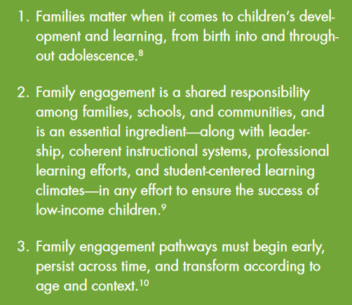
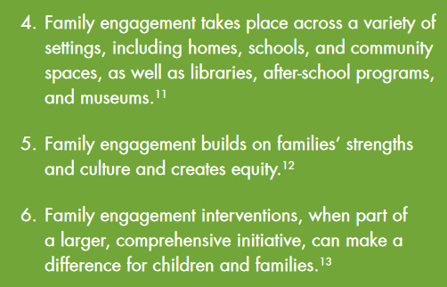
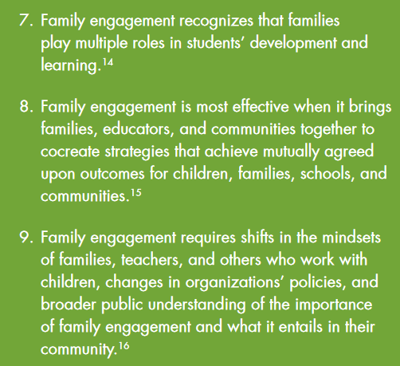
Building family and community engagement
Principles of Research and Practice for
Building Family and Community Engagement

Slide 16



Co-creating family and community engagement
Did you know?
EVERY school in SUSD is required to annually review WITH parents and families!
Title I Parent and Family Engagement Policy
The school-level parent and family engagement policy must be jointly developed with, and distributed to, parents annually. It should be a written policy that is updated periodically to meet the changing needs of parents and the school.
School-Parent Compact
The School-Parent Compact is included in the Title I Parental Involvement Policy; therefore, it is distributed annually. The Compact should be updated periodically to meet the changing needs of parents and the school.
Check Out King Elementary School: https://www.stocktonusd.net/Page/43

Slide 17
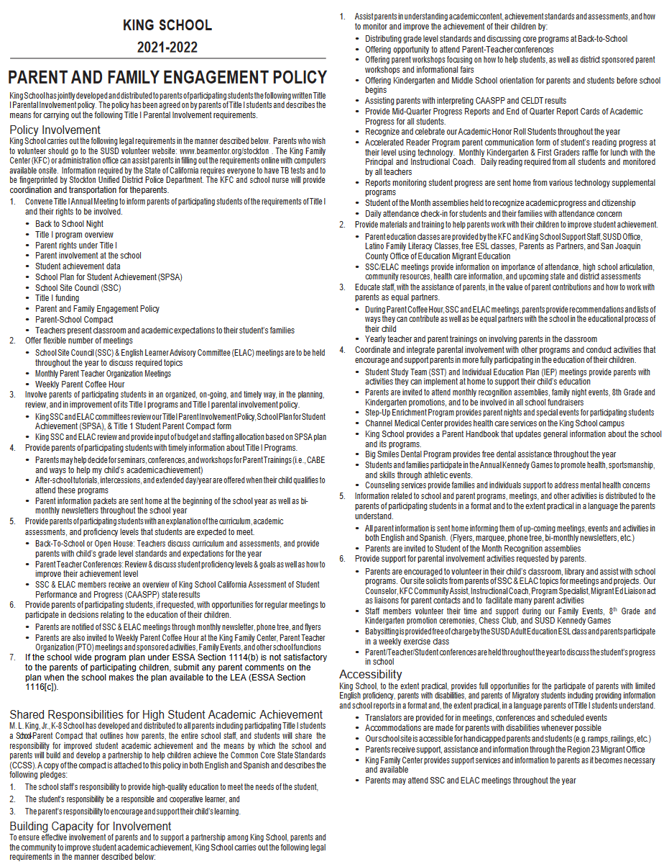
School level engagement policy
1. Convene Title I Annual Meeting to inform parents of participating students of the requirements of Title I and their rights to be involved
2. Offer flexible number of meetings
3. Involve parents of participating students in an organized, on-going, and timely way, in the planning, review, and in improvement of its Title I programs and Title I parental involvement policy
4. Provide parents of participating students with timely information about Title I Programs.
5. Provide parents of participating students with an explanation of the curriculum, academic assessments, and proficiency levels that students are expected to meet
6. Provide parents of participating students, if requested, with opportunities for regular meetings to participate in decisions relating to the education of their children
7. If the school wide program plan under ESSA Section 1114(b) is not satisfactory to the parents of participating children, submit any parent comments on the plan when the school makes the plan available to the LEA (ESSA Section 1116[c]).

Slide 18
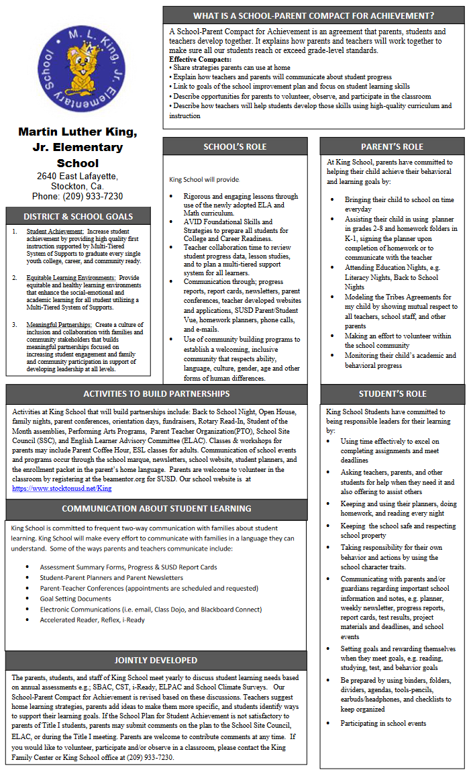
School – parent COMPACT
WHAT IS A SCHOOL-PARENT COMPACT FOR ACHIEVEMENT?
A School-Parent Compact for Achievement is an agreement that parents, students and teachers develop together. It explains how parents and teachers will work together to make sure all our students reach or exceed grade-level standards.
    District & School Goals
    School’s Role
    Parent’s Role
    Student’s Role
    Activities to Build Partnerships
    Communication about student Learning
    Jointly Developed

Slide 19
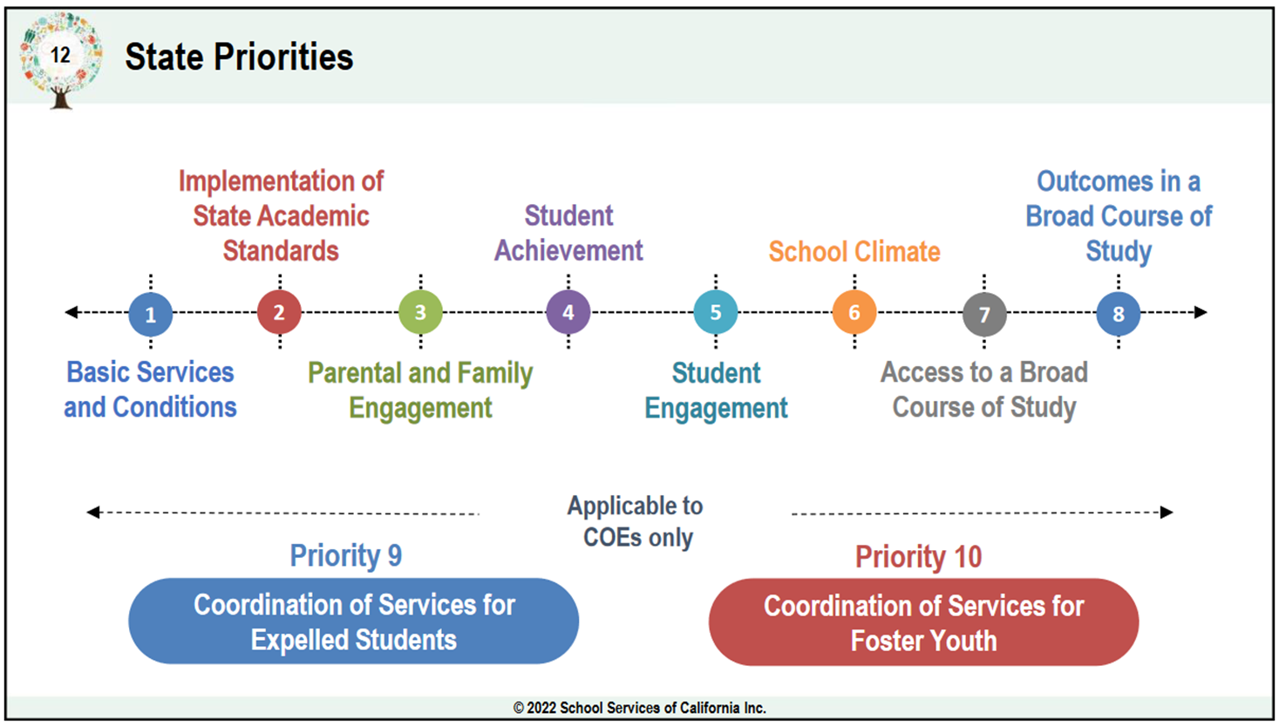
2023-2024 priority recommendations
DECISIONS MADE
TODAY
ARE WHAT IS BEST
FOR KIDS
TO IMPROVE
EDUCATIONAL OUTCOMES
Notes:
Courageous conversations around data, existing programs…hard decisions that will influence or have an impact on existing programs…whether activities or funding adjust. (upcoming conversation)

Slide 20
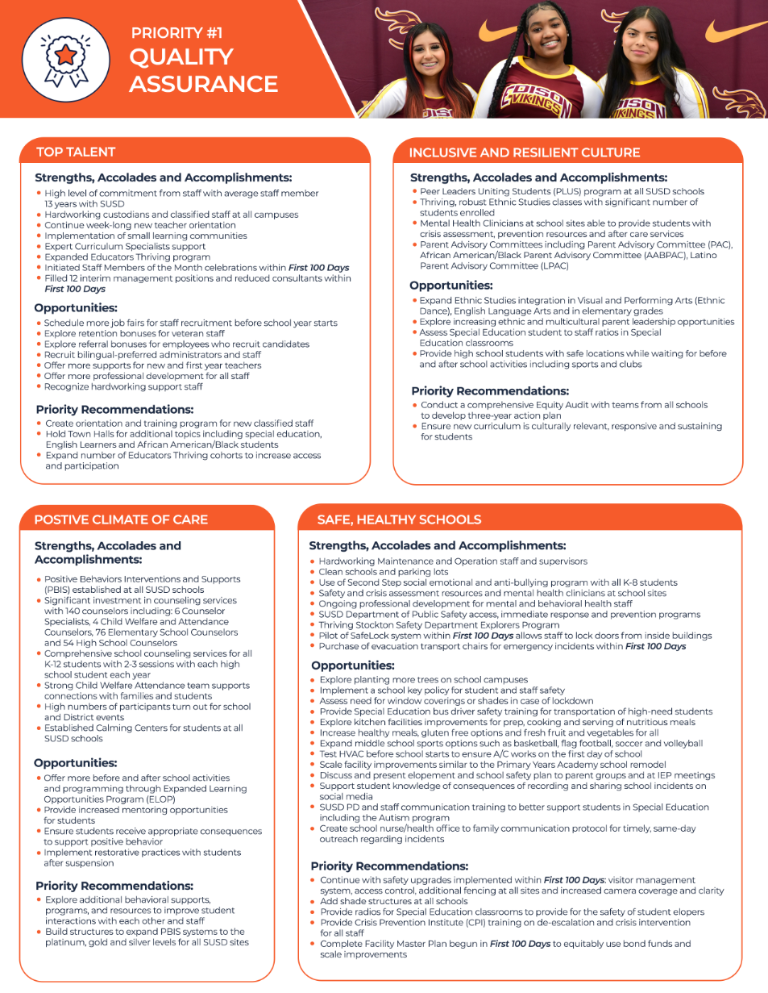
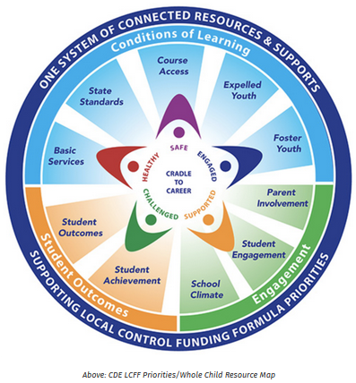
Priority #1 – Quality Assurance
LCAP GOALS
Goal 2 – Equitable Learning Environments
Goal 3 – Meaningful Partnerships
STATE PRIORITIES
1 – Basic Services
3 – Parent and Family Engagement
5 – Student Engagement
6 – School Climate
https://www.cde.ca.gov/eo/in/lcff1sys-resources.asp

Slide 21
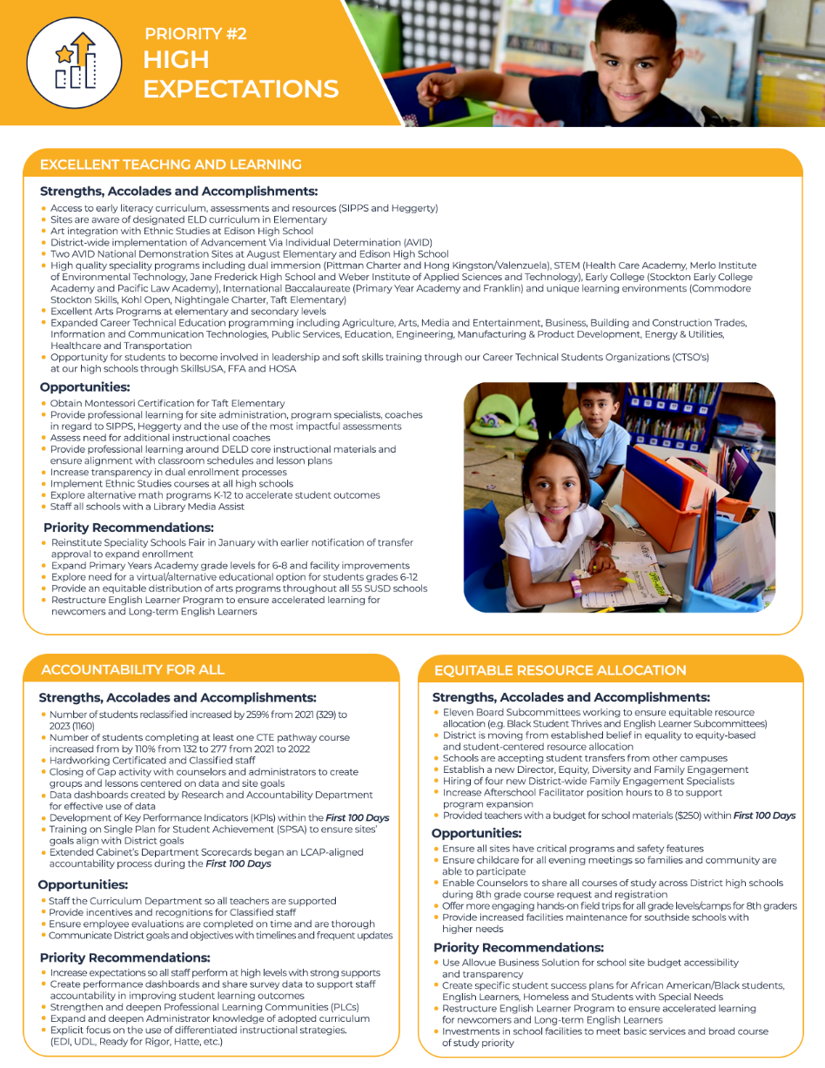
Priority #2 – HIGH EXPECTATIONS
LCAP GOALS
Goal 2 – Equitable Learning Environments
Goal 3 – Meaningful Partnerships
STATE PRIORITIES
1 – Basic Services
3 – Parent and Family Engagement
5 – Student Engagement
6 – School Climate

Slide 22
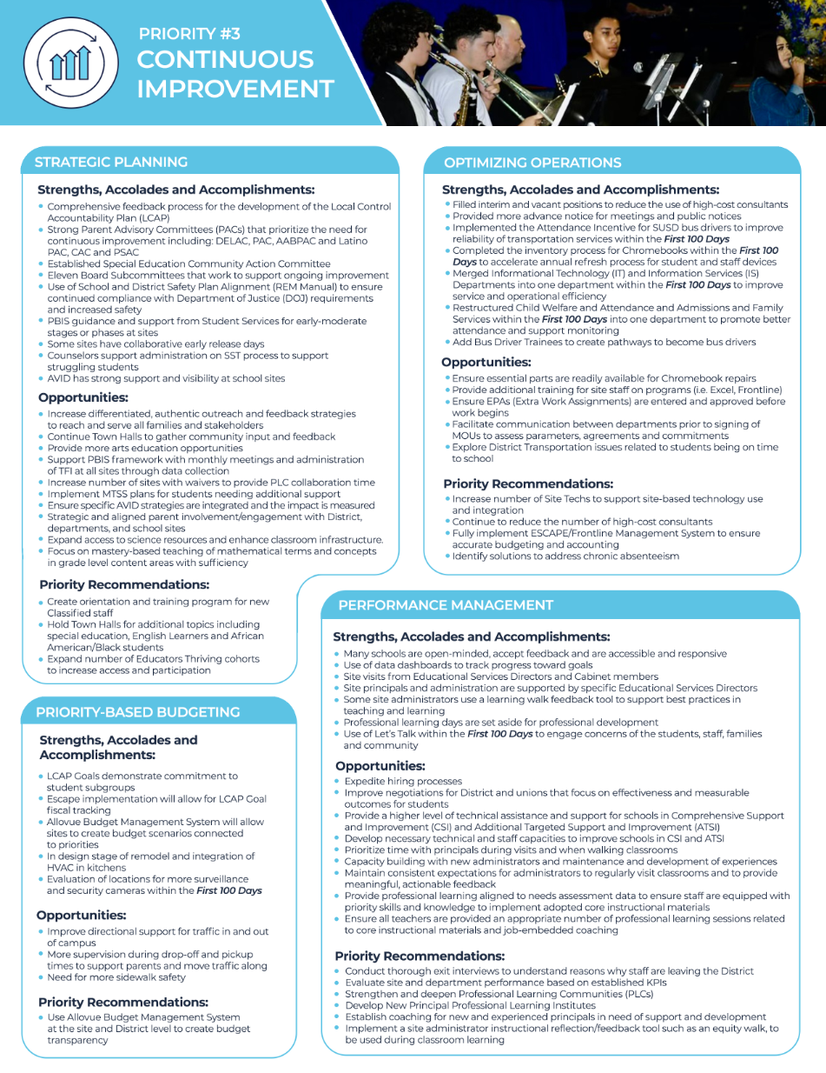
PRIORITY #3 – CONTINUOUS IMPROVEMENT
LCAP GOALS
Goal 1 – Student Achievement
Goal 4, 5, 6 – Differentiated Systems of Support
(Student Groups: Special Education, African American/Black Students, Foster Youth and Homeless Students)
Goal 7, 8 – Intensive Intervention (ATSI and CSI)
STATE PRIORITIES
2 – State Academic Standards (Implementation)
4 – Student Achievement
7 – Access to a Broad Course of Study
8 – Outcomes in a Board Course of Study

Slide 23
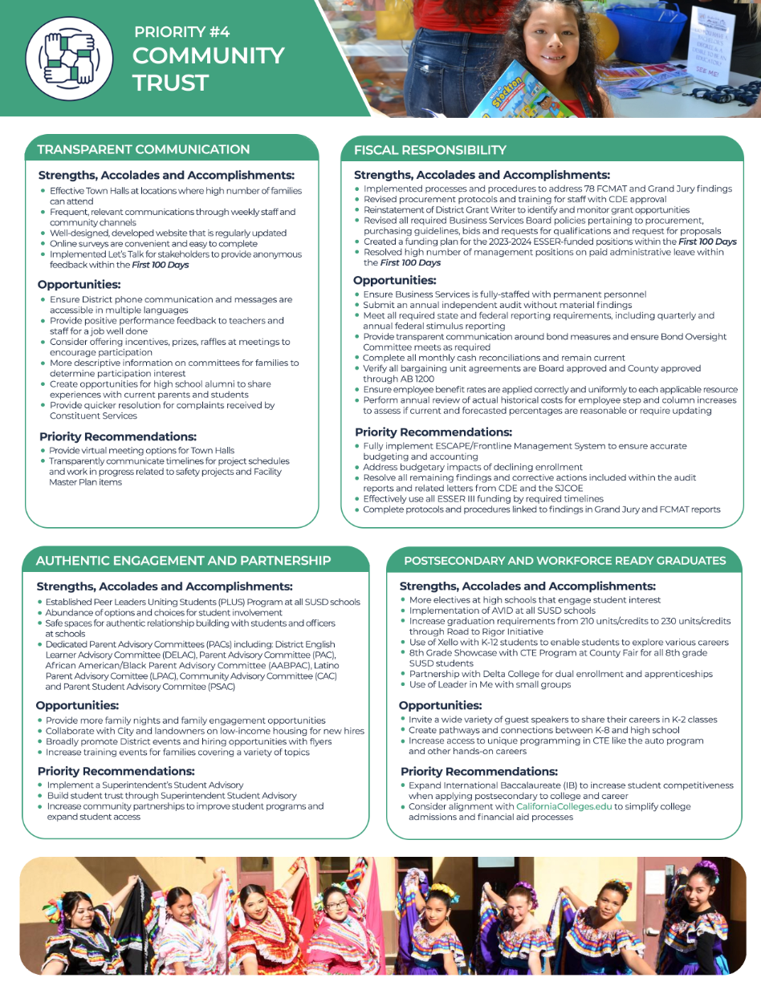
PRIORITY #4 – community trust
LCAP GOALS
Goal 3 – Meaningful Partnerships
STATE PRIORITIES
3 – Parent and Family Engagement
5 – Student Engagement

Slide 24
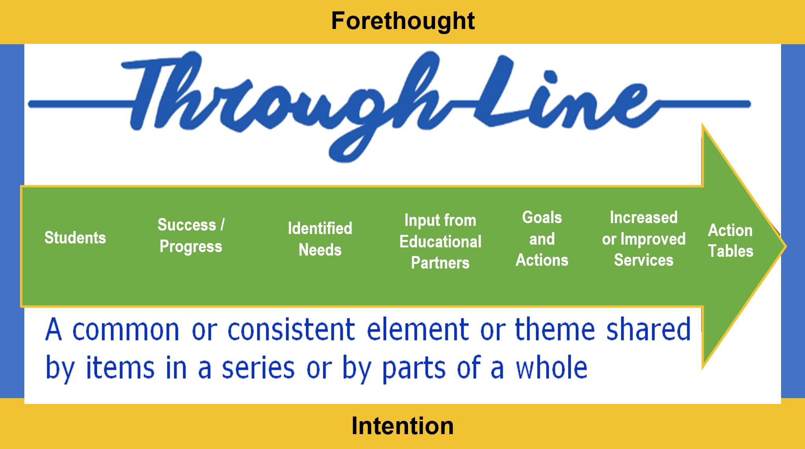
Connecting priorities
Connecting it All
Student Priorities
Parent/Family Priorities
District Priorities
School Site Priorities
Fiscal Priorities

Slide 25
Interactive activity – word wall
Key Priority Terms
Project-Based Learning | Social-Emotional Learning | Culturally Responsive Teaching | Attendance
Early Childhood Education | College and career preparation | Mental health | English Language Learners support
Gifted and Talented education | Community schools | School-based health centers | Cultural awareness
Multilingual support | Technology access | Critical thinking | Leadership
Problem-solving | Positive School Culture | Proficient in Math | Proficient in ELA
Proficient in Science | Safe Schools | Collage and career readiness | Dual enrollment
Part 1- THINK TIME:
We ALL have different priorities.
What are your personal priorities for your student’s education?
List your priorities from 1 to 5, with one being of importance to you.
Then note “WHY” you chose it as your personal priority
PART 2 - SHARE OUT: Report out your personal priorities.
HINT: THERE IS NO WRONG ANSWER!
Notes:
4 people to share…demonstrate that they are not all the same

Slide 26
Interactive activity – word wall - Blank
Personal Priority | My reason for choosing this personal priority
1.
2.
3.
4.
5.
Part 1- THINK TIME:
We ALL have different priorities.
What are your personal priorities for your student’s education?
List your priorities from 1 to 5, with one being of importance to you.
Then note “WHY” you chose it as your personal priority
Google Form Link: https://forms.gle/UbrpzRTBFTSM5wbK9
Notes:
4 people to share…demonstrate that they are not all the same

Slide 27
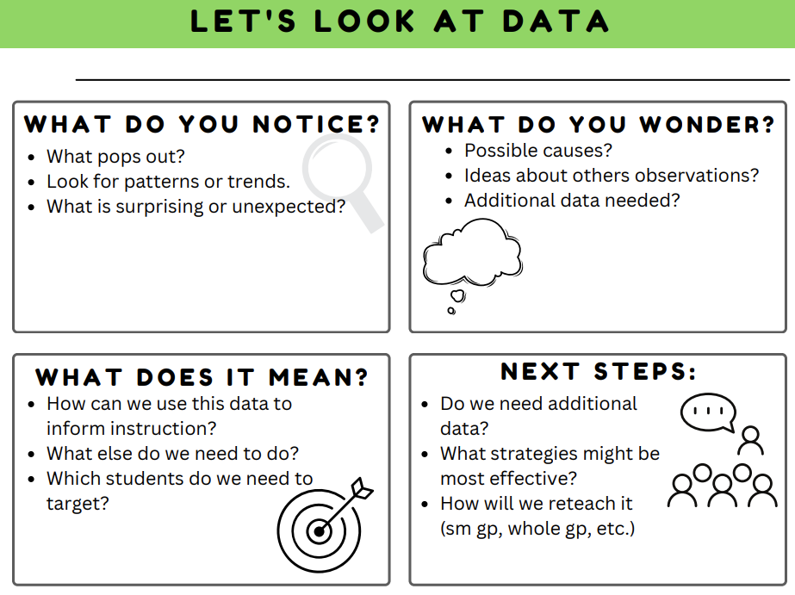
Notice and Wonder protocol
23-24 LCAP Priorities (Major Themes)
from Educational Partners
Equity and inclusion practices
Early literacy and development
Academic program enhancements
Accountability and data-driven decisions
Parent and family engagement, communication, and outreach
Student engagement, enrichment
Recruitment and hiring of additional teachers and support staff

Slide 28
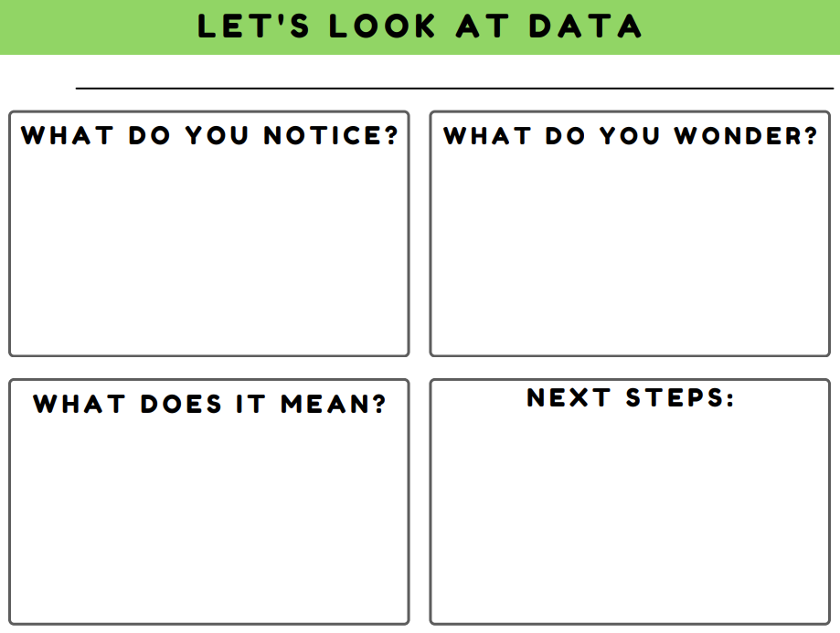
NOTICE AND WONDER PROTOCOL - BLANK
Share Out – 3 Ways:
Chat Box
Verbal
Google Form
https://forms.gle/VKbsri3TDXh5gNp3A
Notes:
***Take A Ways***
Everything is important!
District priorities may not be aligned EXACTLY with educational partner vision
District does have work to do
District will continue to look at data
District will prioritize what is best for ALL kids

Slide 29
Next lcap engagement session
FOCUSED TOPIC:
Data Analysis / District Areas of Need
DATE:
January 19, 2024
TIME:
9:00 a.m. – 10:30 a.m. – Zoom (https://us06web.zoom.us/j/88016804412)
5:30 p.m. – 7:00 p.m. – In Person @ Henry Elementary

Slide 30
LCAP Engagement in 2023-2024
11/28: Introduction: LCAP Fundamentals
12/04: Current District Priorities – 2023-2024 School Year
01/19: LCAP Mid-Year Update and Funding
02/09: Data Analysis / District Areas of Need
02/19: Budget Projections
03/05: Survey Results and Key Findings
03/08: Identified District Goals/Activities
* April 2024: Post Draft 2024-2027 LCAP
* May 2024: Public Hearing 2024-2027 LCAP
* June 2024: Board Adoption 2024-2027 LCAP

Slide 31
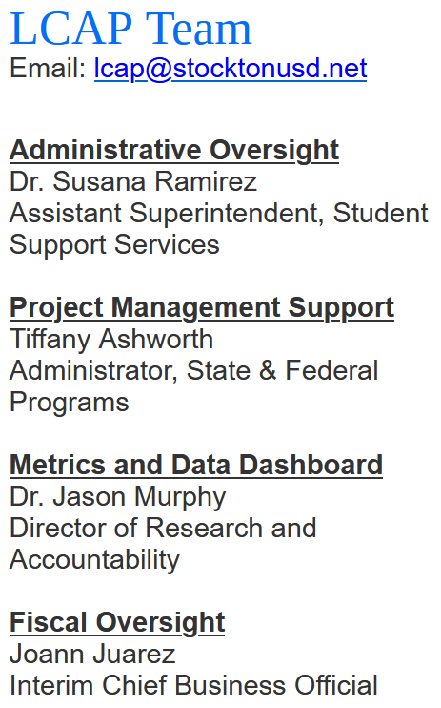
THANK YOU!

Slide 32
WORD WALL ACTIVITY
Did you know WORD WALLS are a common instructional strategy?
WORD WALLS are used for “high frequency” words
Students can identify patterns and relationships in words.
WORD WALLS supporting building phonics, vocabulary, and spelling skills
Support for student during reading and writing activities
Check out this article on WORD WALLS:
https://www.readingrockets.org/classroom/classroom-strategies/word-walls

